Slide 1

EMBEDDED SYSTEM DESIGN PROBLEMS
Submitted by:
Amandeep Kaur (748434)
Ronak Kumar Sharma(747019)
Shweta (747925)

Slide 2
Exiting embedded systems
IOT Based Smart Security Gadget for Women’s Safety
IOT based smart signage system with gender classification with raspberry pi
IOT based vein detection system

Slide 3
IOT Based Smart Security Gadget for Women’s Safety
Introduction
It is a small gadget one can wear as a band.
There is a button ,whenever it is pressed a help message along with location is sent to the registered contacts.
Well as there are sensors related to pulse rate and body posture and when the value increases threshold ,then also information is sent
A buzzer is also there to alert the people nearby.

Slide 4
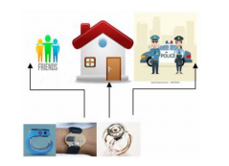
Requirements
Raspberry pi zero
Sensors-ADXL Motion Sensor, Pulse Rate Sensor
GPS(Global Positioning System)
GSM(Global System For Mobile Communication)
ADC
Alarm Buzzer

Slide 5
Problem
If the registered contacts are not nearby, then there is no use of such system
In case any problem occurs, then according to this gadget there is no way the culprit can be identified.

Slide 6
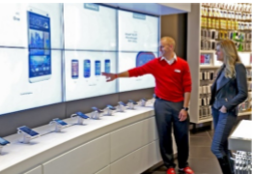
IOT based smart signage system with gender classification with raspberry pi
The advertisement industry is growing at a fast pace which is the major
reason behind the invention of the digital signage system.
Haar cascade measurement is incorporated into the camera to take the
features of the person into account.
Raspberry pi provides the information to the FERET database which
performs calculations, so that the presence of men and women can be estimated.

Slide 7

IOT based smart signage system with gender classification and price control with raspberry pi
A cost-efficient system as numerous adds, notices, and information shares one platform.
Gender classification is done in this system which is a time-saving approach.
.

Slide 8
Design issue
Data regarding visiting adds is not transferred to related industries through IOT. This a reason that companies pay continuously even for non-visiting adds.

Slide 9
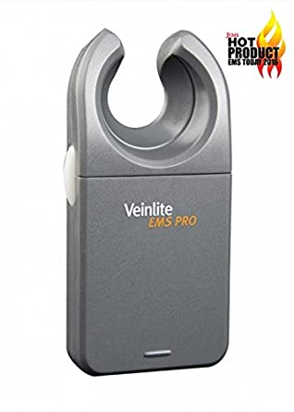
IOT based Vein detection system
Doppler ultrasound used to check blood flow in the arteries or veins of your legs, arms, or neck.
Such like that vein detector was created to allow health care providers and EMS technicians to find veins in the limbs and scalp.

Slide 10
IOT based Vein detection system Application:
To find vein among elder, obese people and children
Mapping superficial veins
Varicose veins imaging
Identifying spider veins

Slide 11
Problem
No provision that doctors can examine from remote locations
There is no such system that details of patients get stored somewhere as details of patients are very important . And also details should be up-to-date.

Slide 12
Reference
James.M.T(2020)he best 3 portable infrared vein finder(detector). https://www.infrared-light-therapy.com/infrared-vein-finder/
Tejonidhi M.R, Aishwarya, Chaithra K.S, Dayana M.K,Nagamma H (2019) IOT Based Smart Security Gadget For Women’s Safety. https://scihub.tw/https://ieeexplore.ieee.org/document/7972266
Lee.D.,Lee.J., Lee.S., Kim.D., Lee.M., Cha.J., Mariappan.J.(2017).Design of low cost real-time Audience Adaptive Digital signage using harr cascade Facial Measures.IJACTa. https://www.researchgate.net/publication/317714321

